Slide 1
Connecting Themes in
Social Studies

Slide 2
Conflict & Change
When there is conflict within or between societies, change is the result.

Slide 3
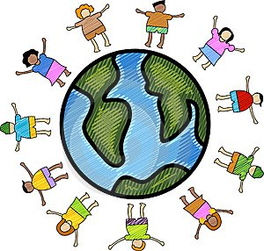
Culture
The culture of a society is the product of the religion, beliefs, customs, traditions, and government of that society.

Slide 4
Gain from Trade
People trade voluntarily when they expect to gain.

Slide 5
Governance
As a society increases in complexity and interacts with other societies, the complexity of the government also increases.

Slide 6
Human-Environmental Interaction
Humans, their society, and the environment affect each other.

Slide 7
Location
Location affects a society’s economy, culture, and development.

Slide 8
Movement/Migration
The movement or migration of people and ideas affects all societies involved.

Slide 9
Production, Distribution, Consumption
The production, distribution, and consumption of goods/services produced by the society are affected by the location, customs, beliefs, and laws of the society.
Notes:
2

Slide 10

Time, Continuity, Change
While change occurs over time, there is continuity to the basic structure of a society.
Notes:
K, 1, 2

Slide 11
Scarcity
Scarcity of all resources forces people to make choices and these choices always incur a cost.

Slide 12
Beliefs & Ideals
The beliefs and ideals of a society influence the social, political, and economic decisions of that society.

Slide 13
Conflict Resolution
Societies resolve conflicts through legal procedures, force, and/or compromise.

Slide 14
Distribution of Power
Distribution of power in government is a product of existing documents and laws combined with contemporary values and beliefs.

Slide 15
Individuals, Groups, Institutions
The actions of individuals, groups, and/or institutions affect society through intended and unintended consequences.

Slide 16

Rule of Law
In a democracy, rule of law influences the behavior of citizens, establishes procedures for making policies, and limits the power of government.

Slide 17
Technological Innovations
Technological innovations have consequences, both intended and unintended, for society.

